Slide 1
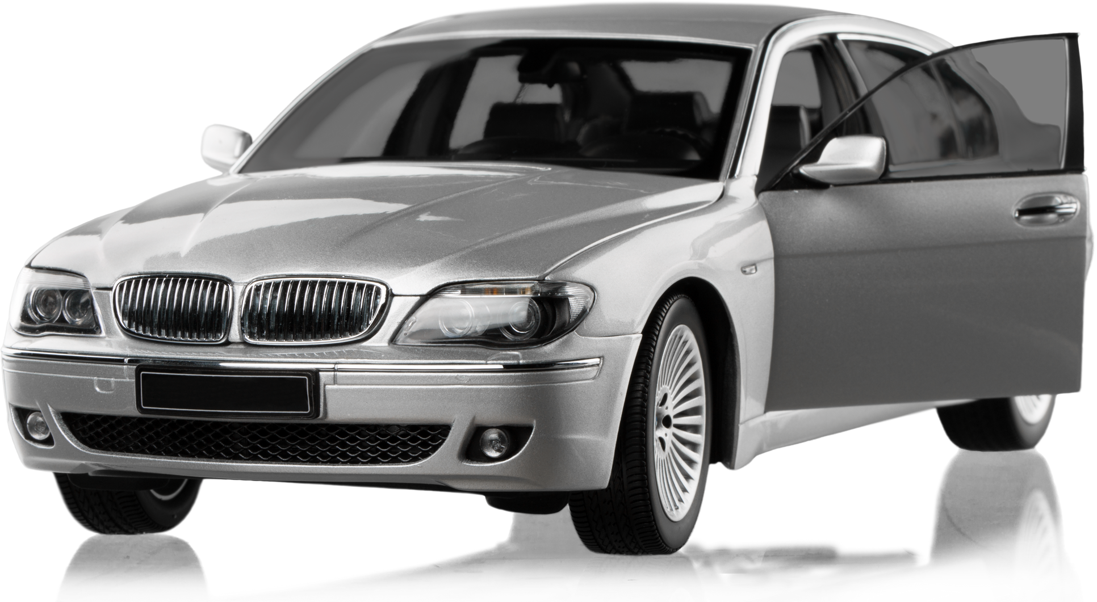
ELECTRIFYING INDIA: ATLIQ MOTORS VISION FOR Electric Vehicles
SUCCESS
PRESENTED BY SRABANA BAIDYA

Slide 2

TABLE OF CONTENTS
Introduction
Table Description
Data modelling
Insights & Visualizations
Key Findings
Recommendations
Conclusion
"Electric cars are the future, and the future is now."

Slide 3


INTRODUCTION
AtliQ Motors, a leading name in the global automotive industry, is known for its innovative approach to electric and hybrid vehicle technology. Having achieved significant success in North America with a strong 25% market share in the EV and hybrid segment, the company is now setting its sights on expanding its footprint into India—a market with immense potential but unique challenges.
With a current market share of less than 2% in India, AtliQ Motors recognizes the importance of understanding the local ecosystem before introducing its flagship models. To ensure a well-informed and effective market entry, the company is committed to conducting an in-depth analysis of India’s EV and hybrid landscape. This initiative, spearheaded by Bruce Haryali, aims to uncover key insights into consumer behavior, market demand, competition, and government policies, laying the foundation for a successful expansion into this promising market.

Slide 4
TABLE DESCRIPTION
Descriptions for the columns in the CSV files related to electric vehicle sales data. These datasets include sales by state, sales by maker, and a date dimension table useful for time-series analysis.
electric_vehicle_sales_by_state.csv
date: The date on which the data was recorded. Format: DD-MMM-YY. (Data is recorded on a monthly basis)
state: The name of the state where the sales data is recorded. This indicates the geographical location within India.
vehicle_category: The category of the vehicle, specifying whether it is a 2-Wheeler or a 4-Wheeler.
electric_vehicles_sold: The number of electric vehicles sold in the specified state and category on the given date.
total_vehicles_sold: The total number of vehicles (including both electric and non-electric) sold in the specified state and category on the given date.
electric_vehicle_sales_by_makers.csv
date: The date on which the sales data was recorded. Format: DD-MMM-YY. (Data is recorded on a monthly basis)
vehicle_category: The category of the vehicle, specifying whether it is a 2-Wheeler or a 4-Wheeler.
maker: The name of the manufacturer or brand of the electric vehicle.
electric_vehicles_sold: The number of electric vehicles sold by the specified maker in the given category on the given date.
dim_date.csv
date: The specific date for which the data is relevant. Format: DD-MMM-YY. (Data is recorded on a monthly basis)
fiscal_year: The fiscal year to which
the date belongs. This is useful for financial and business analysis.
quarter: The fiscal quarter to which the date belongs. Fiscal quarters are typically divided as Q1, Q2, Q3, and Q4.

Slide 5
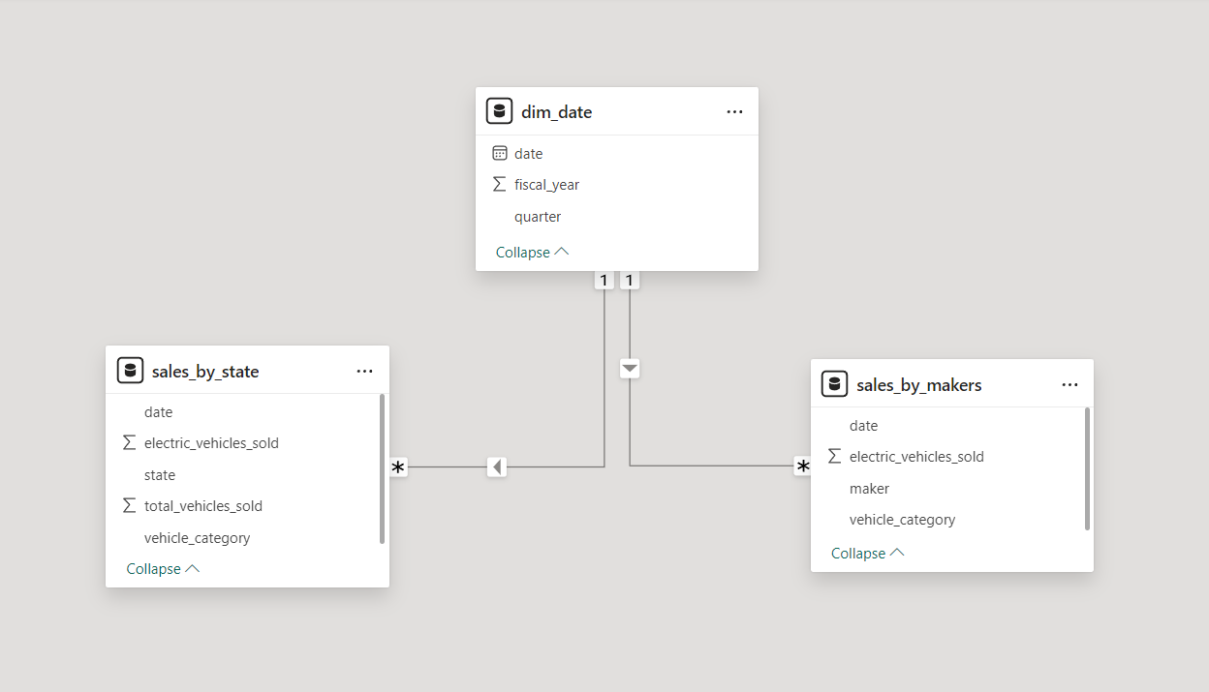
DATA MODELLING

Slide 6
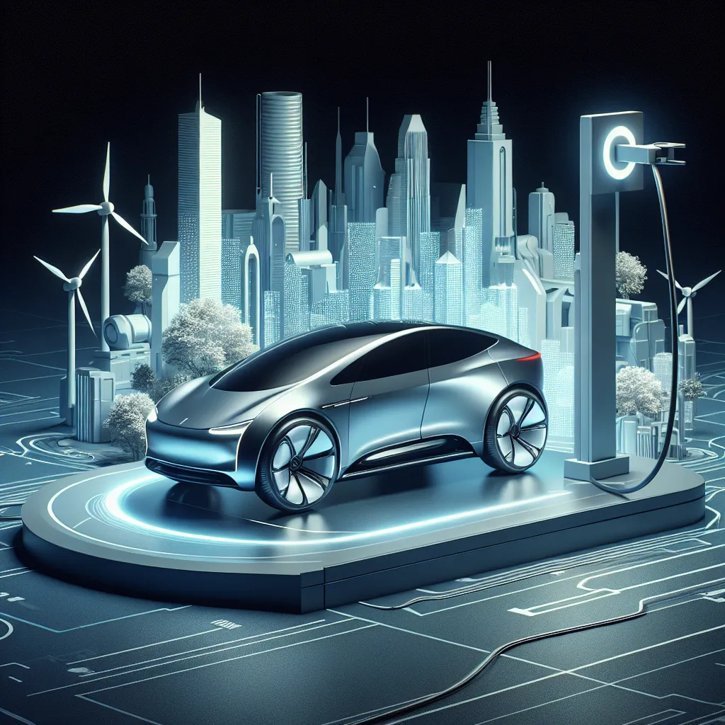
INSIGHTS &
VISUALIZATION

Slide 7
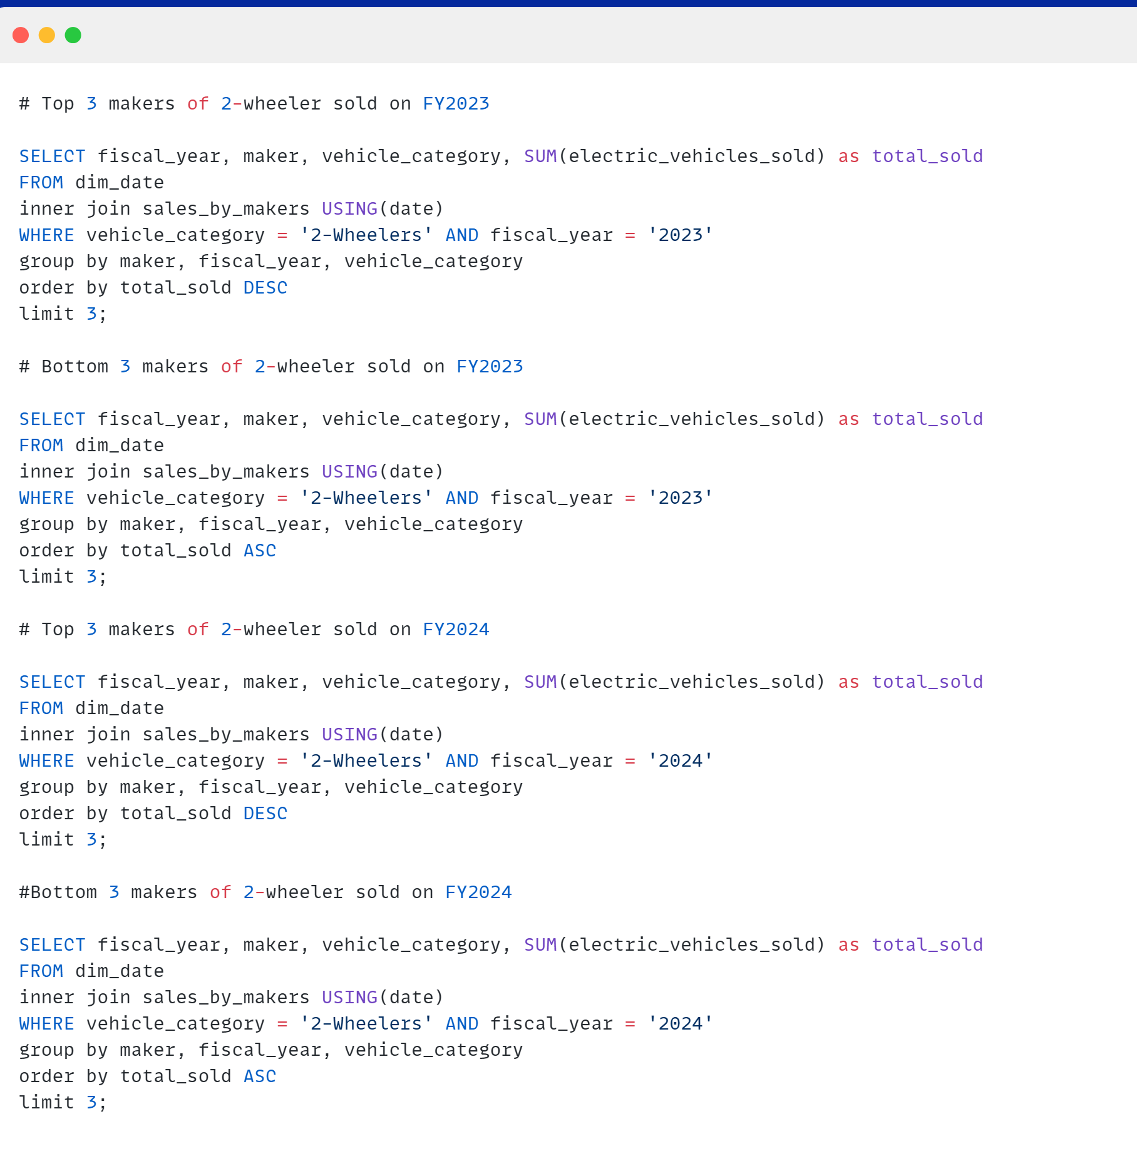
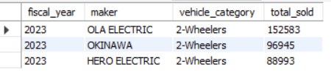
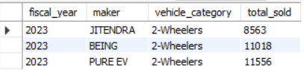
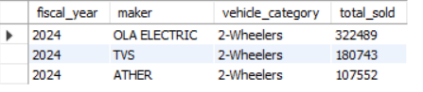
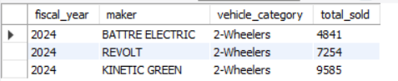
1. List the top 3 and bottom 3 makers for the fiscal years 2023 and 2024 in terms of the number of 2-wheelers sold.
Top 3 in 2023
Bottom 3 in 2023
Top 3 in 2024
Bottom 3 in 2024

Slide 8
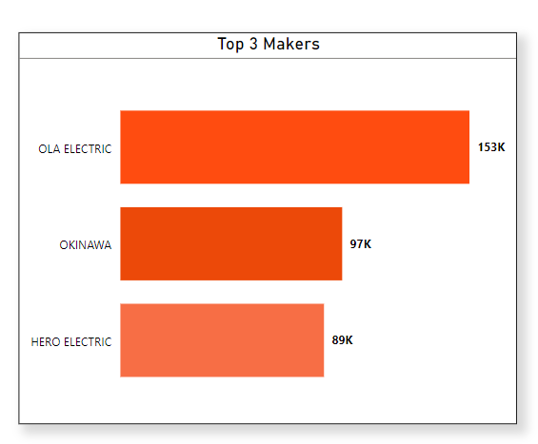
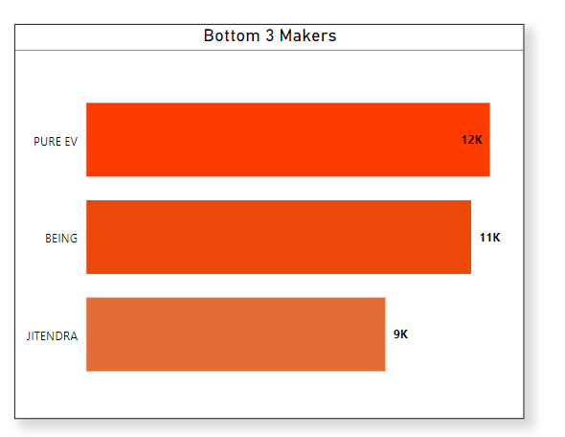
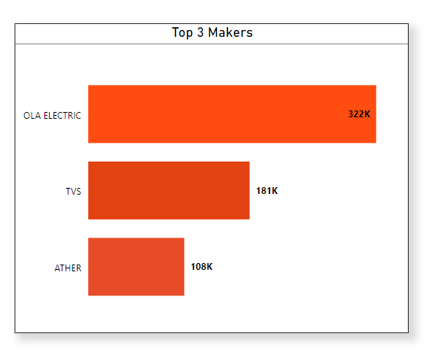
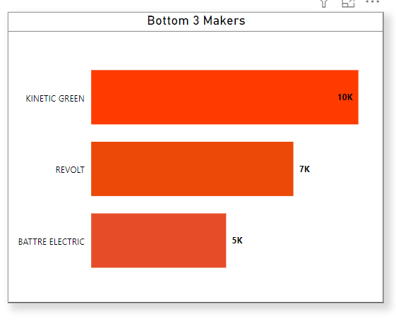
Top 3 and bottom 3 makers for the fiscal years 2023 and 2024 in terms of the number of 2-wheelers sold.
2023
2024

Slide 9
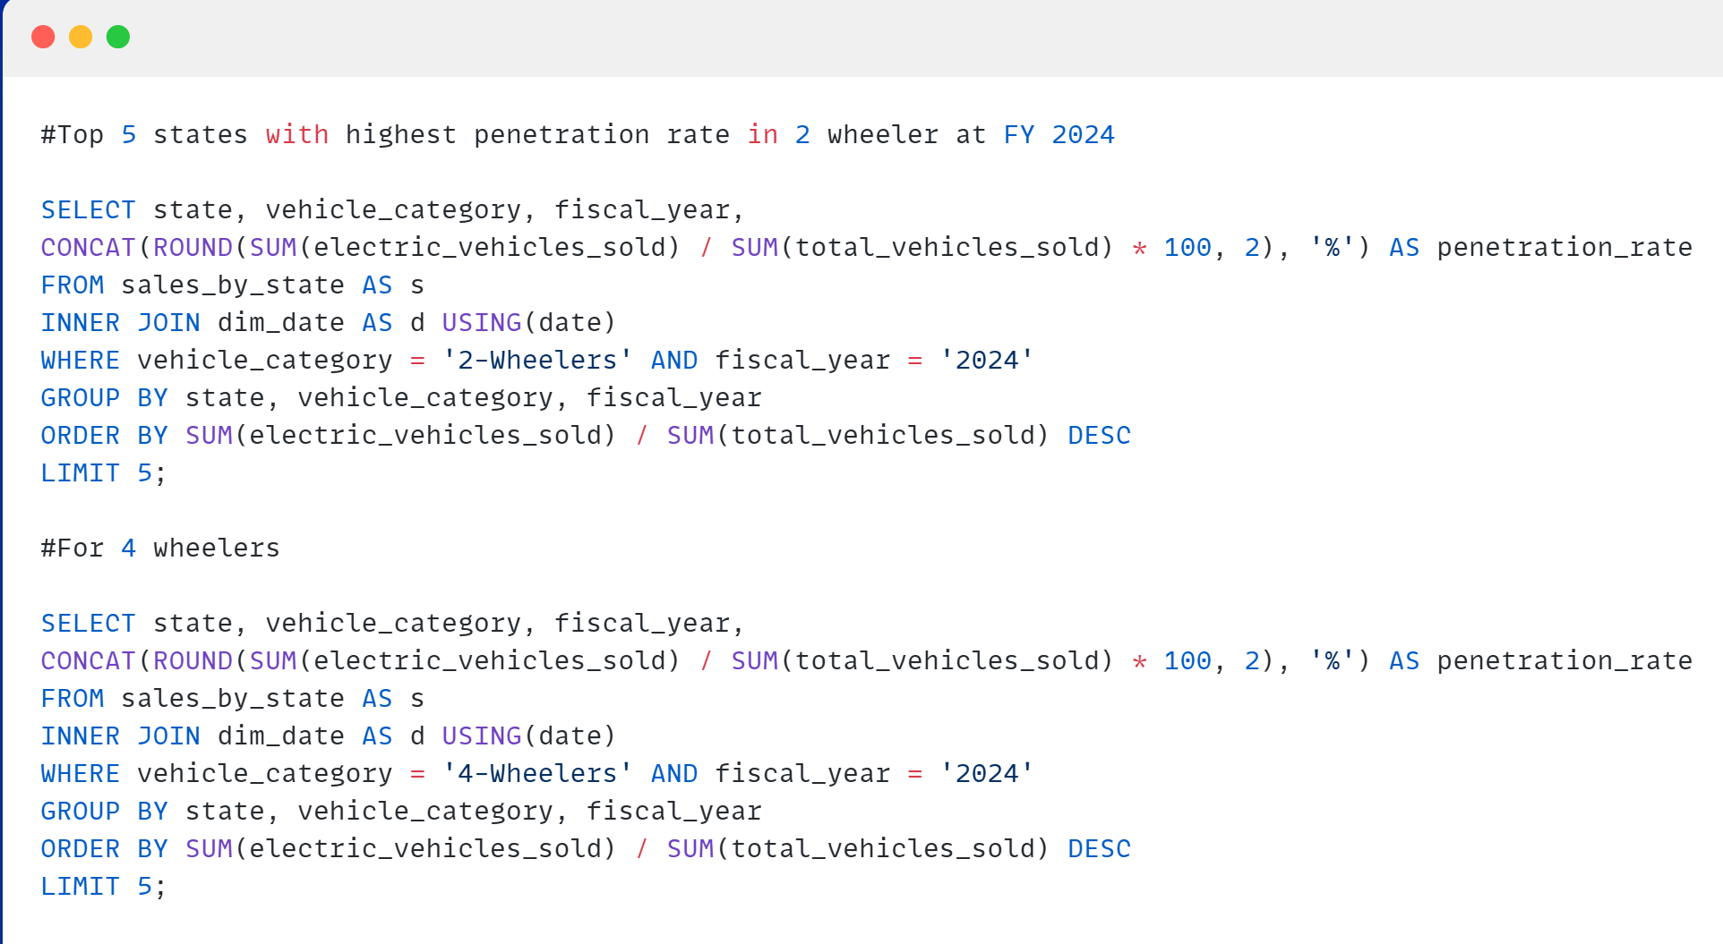
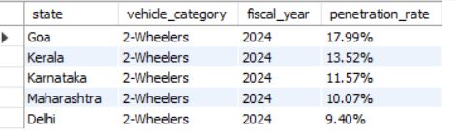
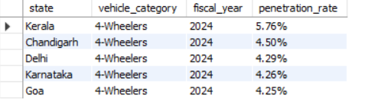
2. Identify the top 5 states with the highest penetration rate in 2-wheeler and 4-wheeler EV sales in FY 2024.
2-Wheeler
4-Wheeler

Slide 10
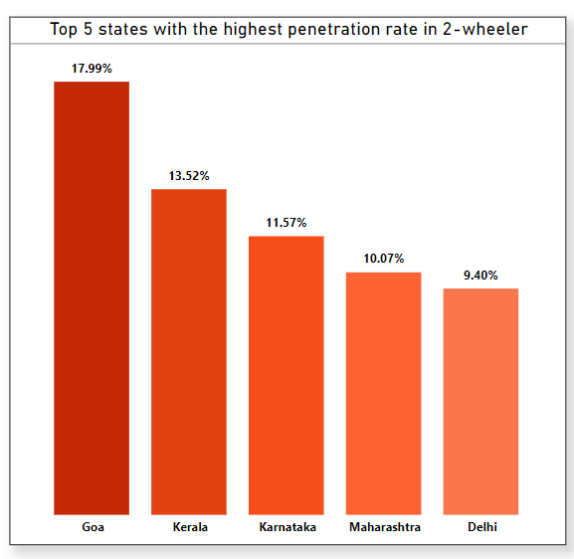
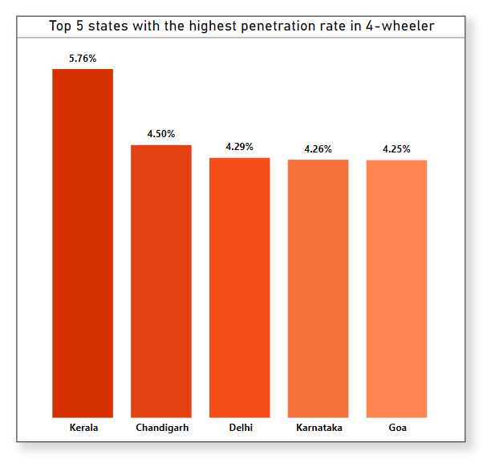
Top 5 states with the highest penetration rate in 2-wheeler and 4-wheeler EV sales in FY 2024.

Slide 11
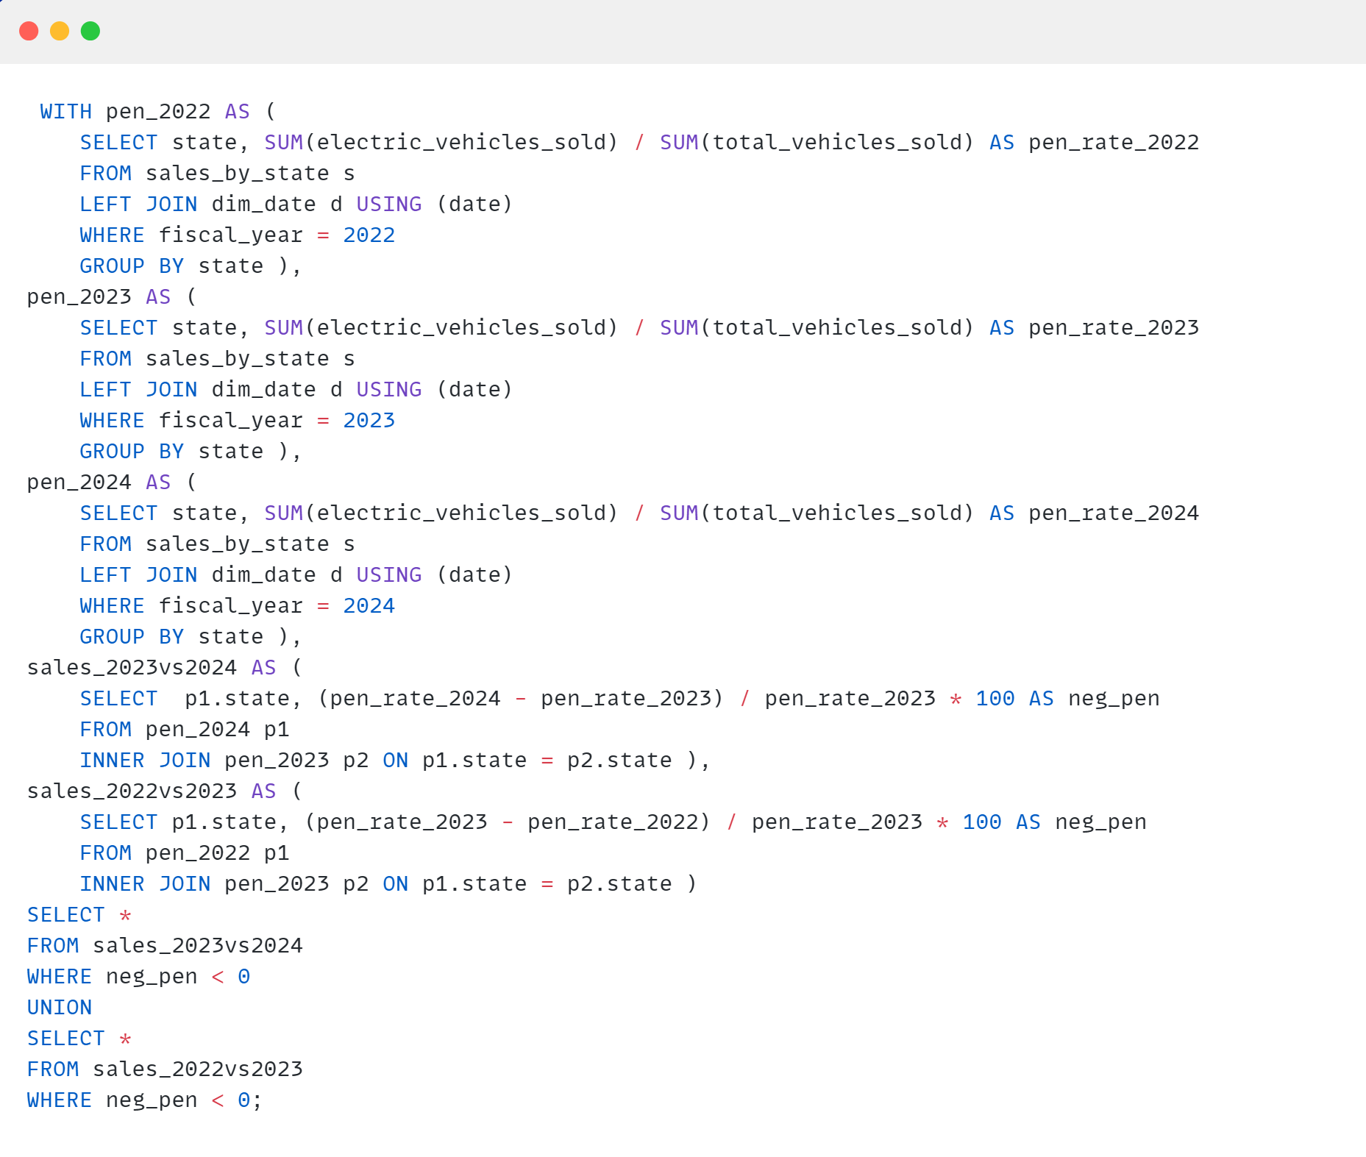
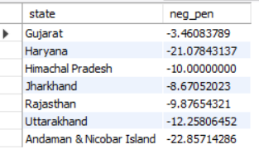
3. List the states with negative penetration (decline) in EV sales from 2022 to 2024?

Slide 12
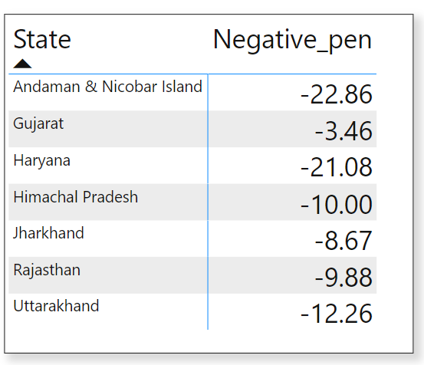
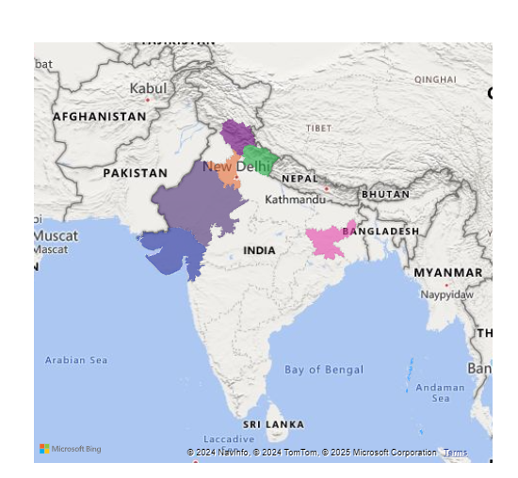
States with negative penetration (decline) in EV sales from 2022 to 2024

Slide 13
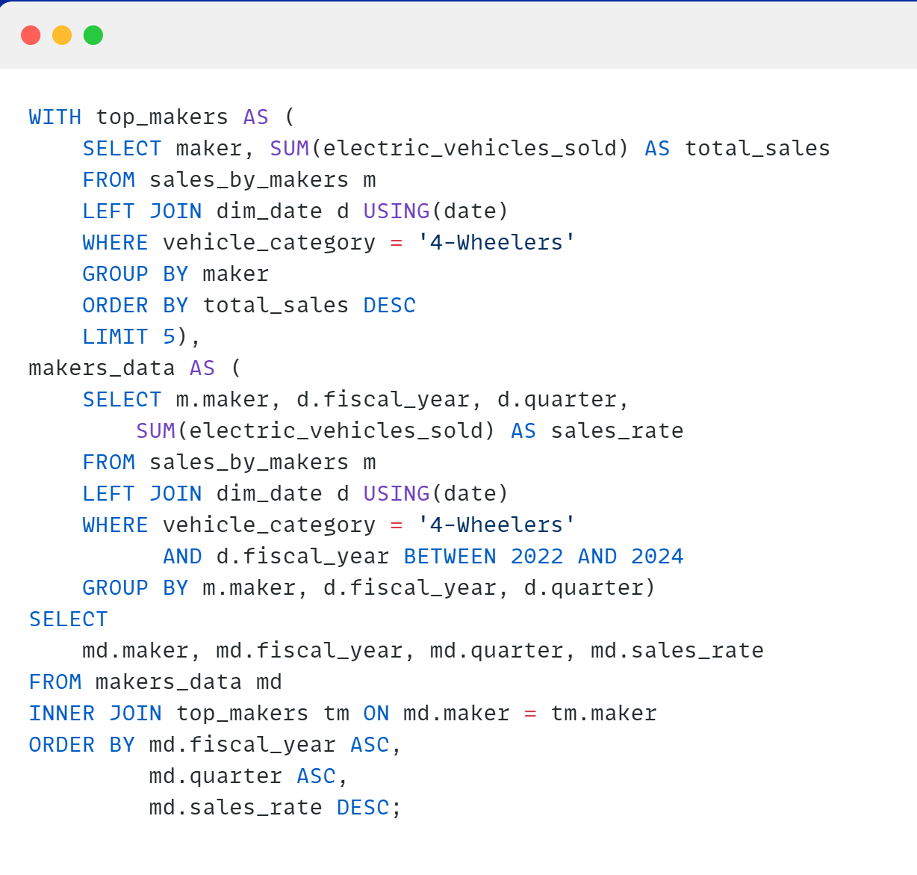
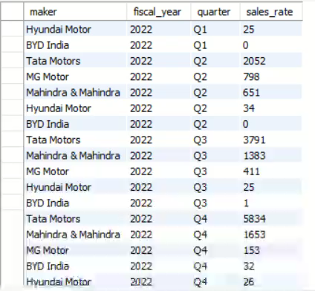
4. What are the quarterly trends based on sales volume for the top 5 EV makers (4-wheelers) from 2022 to 2024?

Slide 14
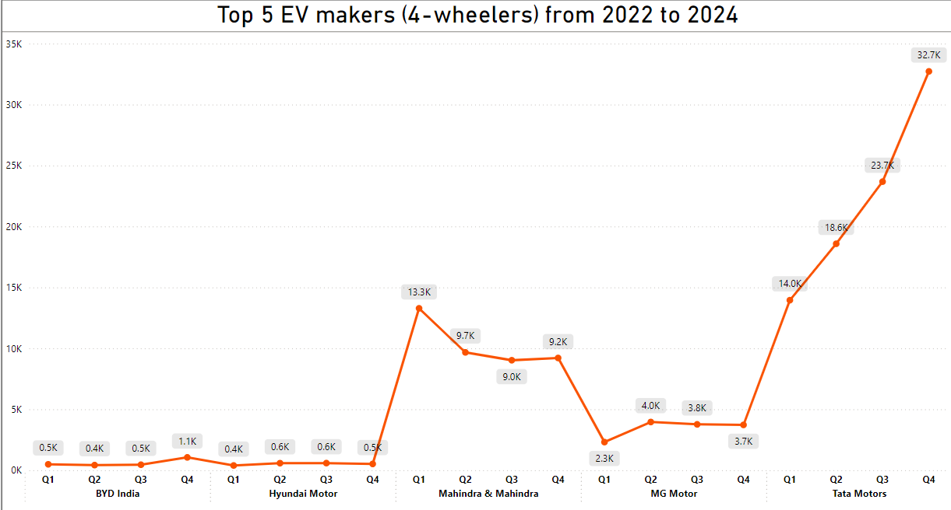
Quarterly trends based on sales volume for the top 5 EV makers (4-wheelers) from
2022 to 2024.

Slide 15
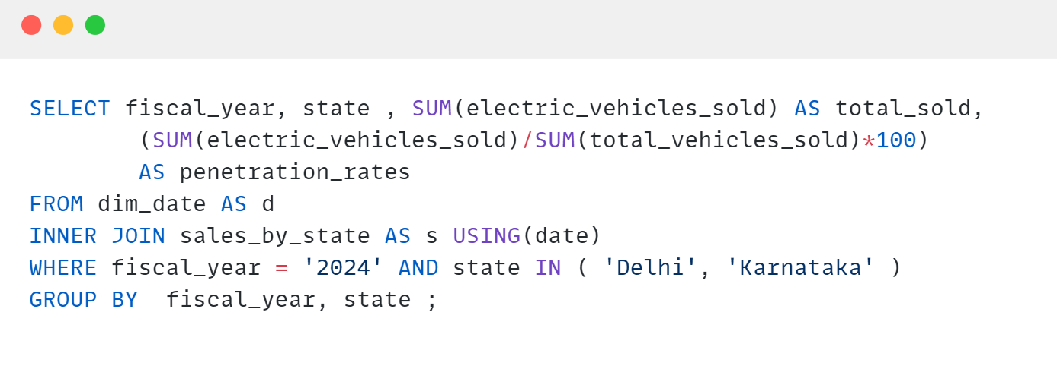
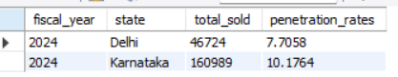
5. How do the EV sales and penetration rates in Delhi compare to Karnataka for 2024?

Slide 16
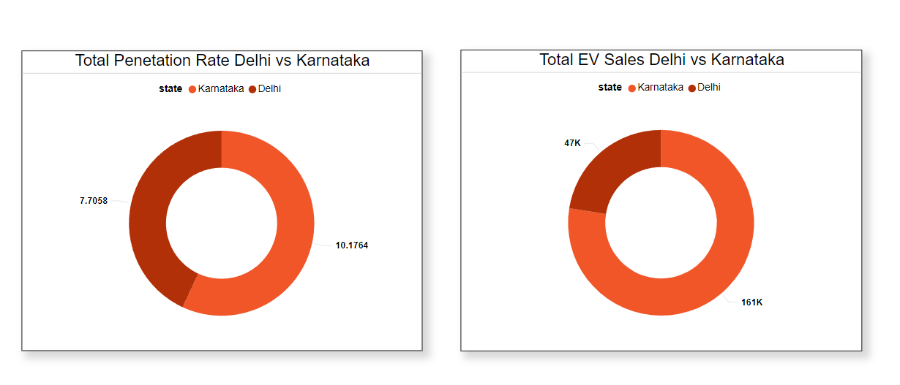
EV sales and penetration rates in Delhi compare to Karnataka for 2024
Penetration rate
EV sales
V
S

Slide 17
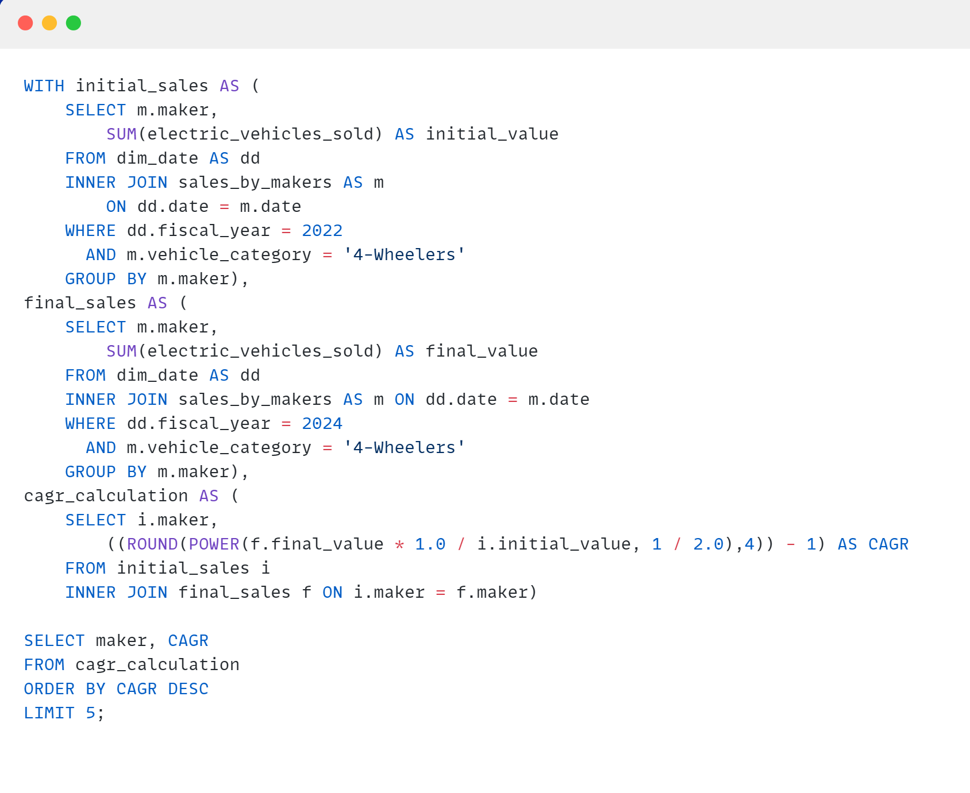
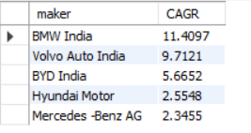
6. List down the compounded annual growth rate (CAGR) in 4-wheeler units for the top 5 makers from 2022 to 2024 .

Slide 18
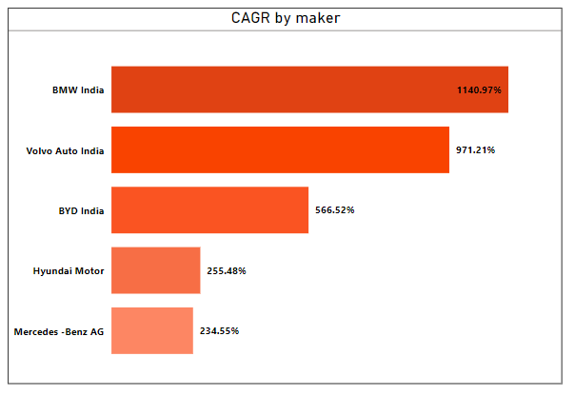
Compounded annual growth rate (CAGR) in 4-wheeler units for the top 5 makers from 2022 to 2024 .

Slide 19
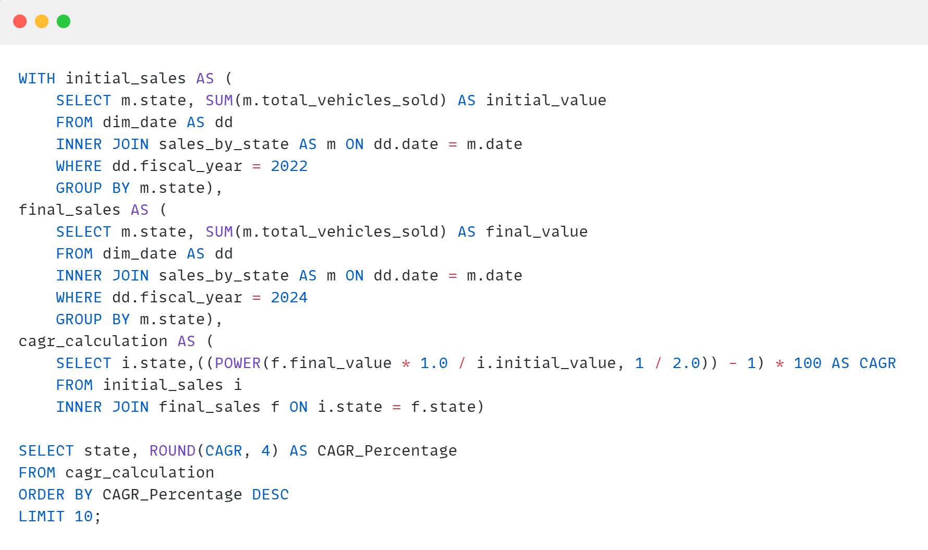
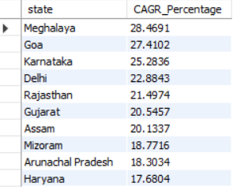
7. List down the top 10 states that had the highest compounded annual growth rate (CAGR) from 2022 to 2024 in total vehicles sold.

Slide 20
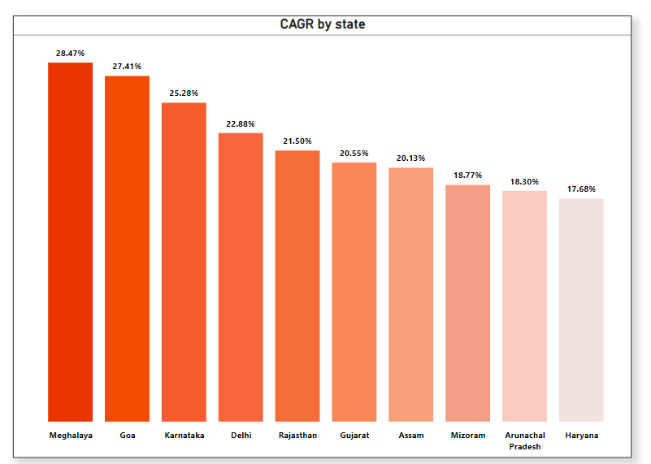
Top 10 states that had the highest compounded annual growth rate (CAGR) from 2022 to 2024 in total vehicles sold.

Slide 21
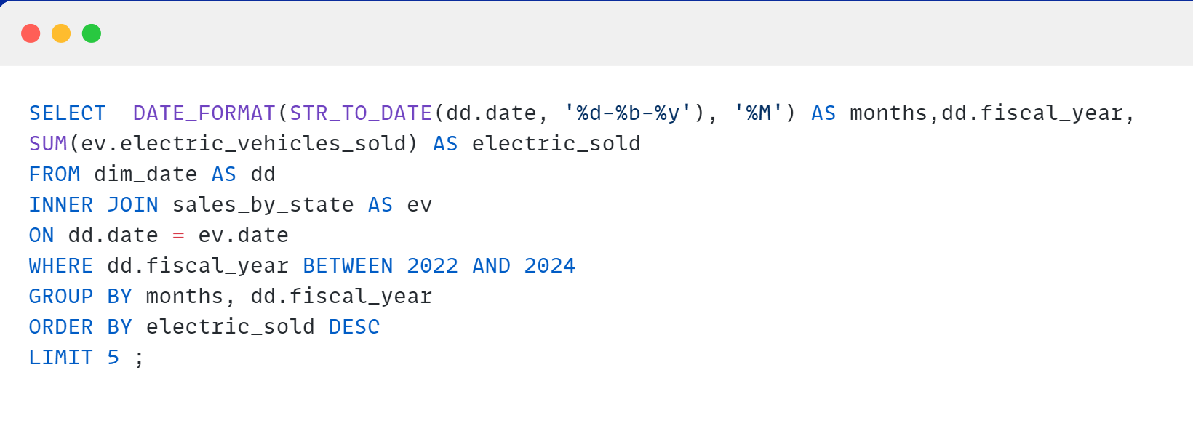
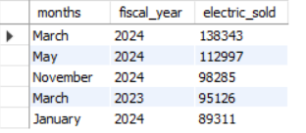
8. What are the peak and low season months for EV sales based on the data from 2022 to 2024.?

Slide 22
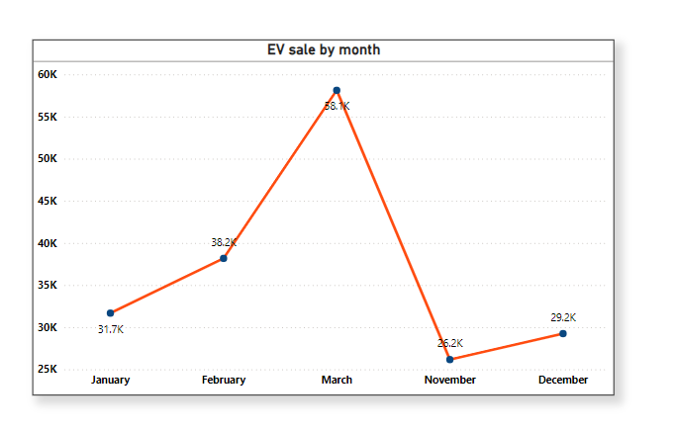
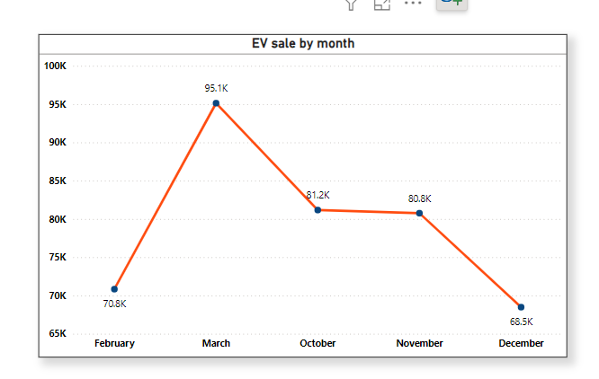
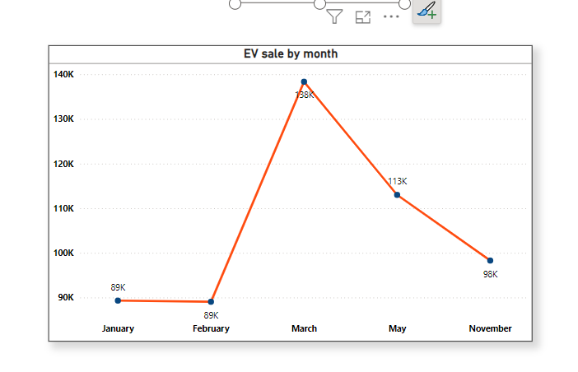
Peak and low season months for EV sales based on the data from 2022 to 2024.
2022
2023
2024

Slide 23
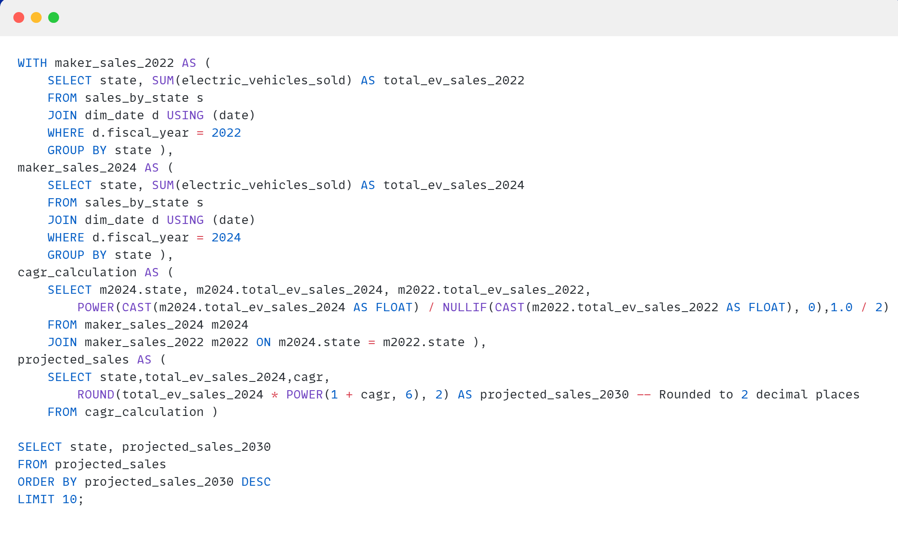
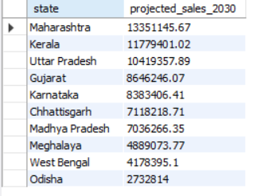
9. What is the projected number of EV sales (including 2-wheelers and 4-wheelers) for the top 10 states by penetration rate in 2030, based on the compounded annual growth rate (CAGR) from previous years?

Slide 24
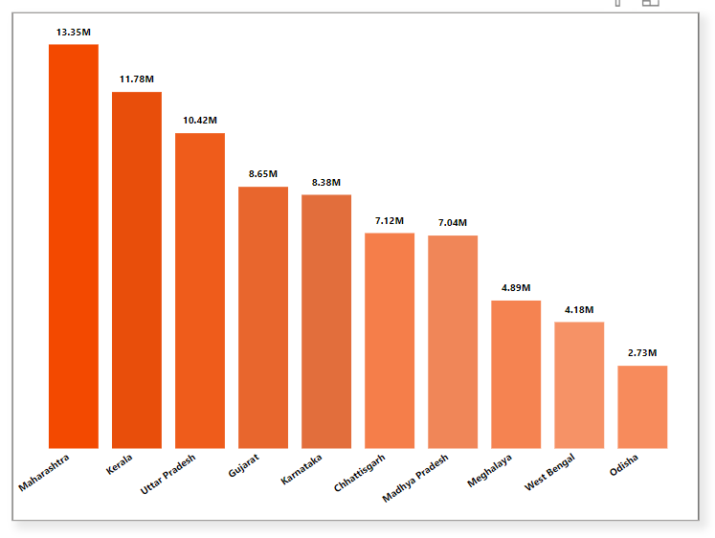
Top 10 states by penetration rate in 2030, based on the compounded annual growth rate (CAGR) from previous years

Slide 25
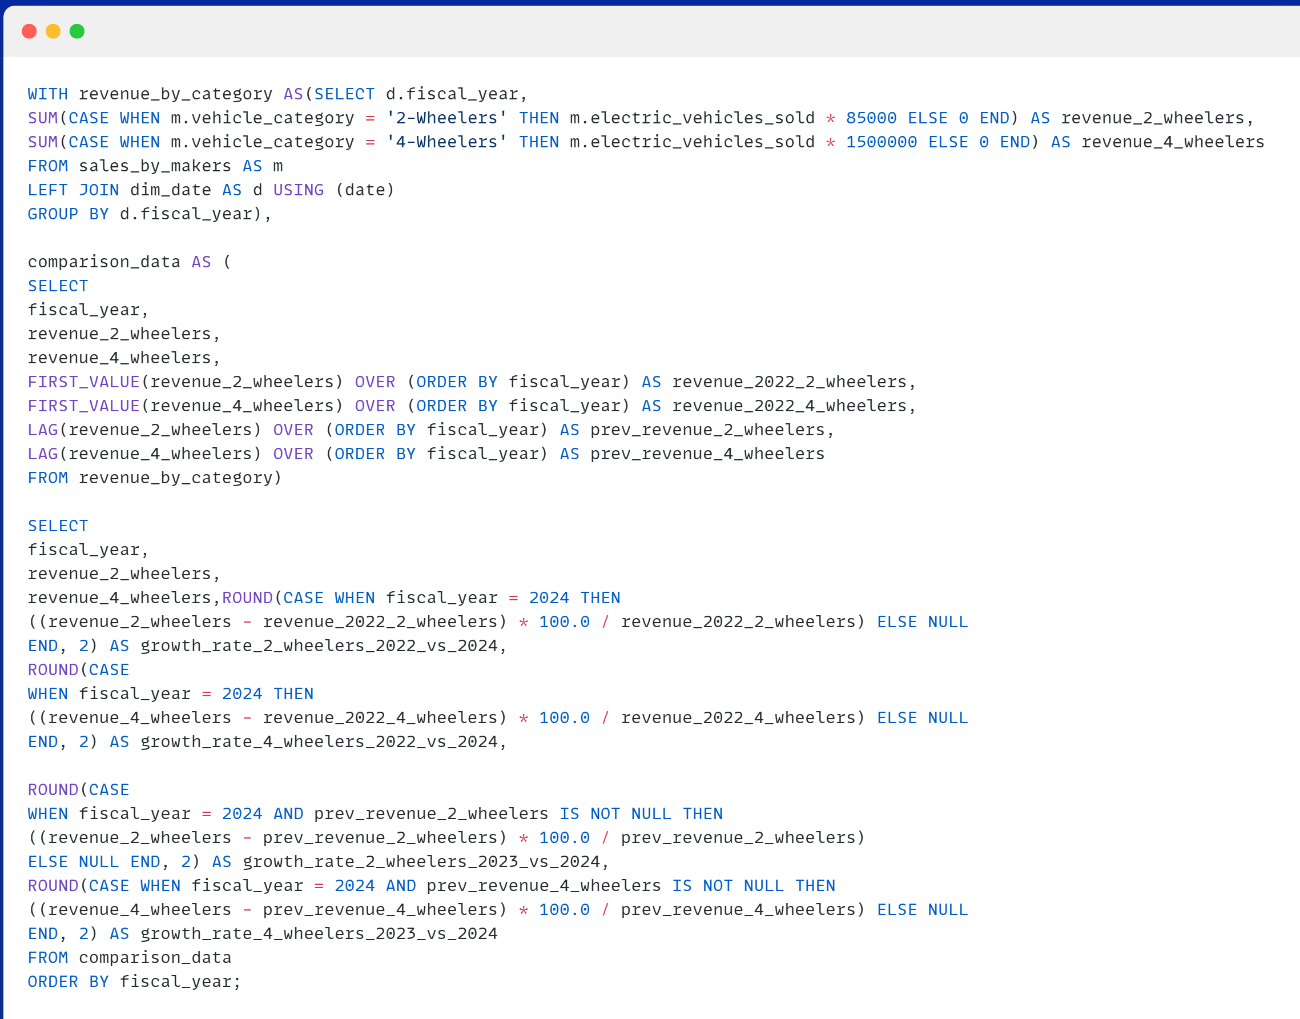
10. Estimate the revenue growth rate of 4-wheeler and 2-wheelers EVs in India for 2022 vs 2024 and 2023 vs 2024, assuming an average unit price.

Slide 26
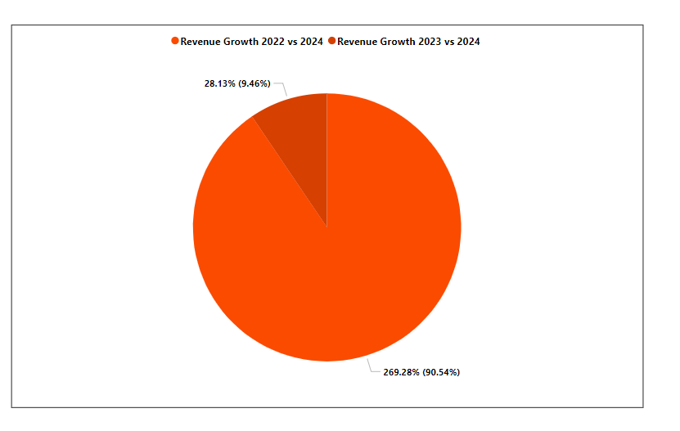
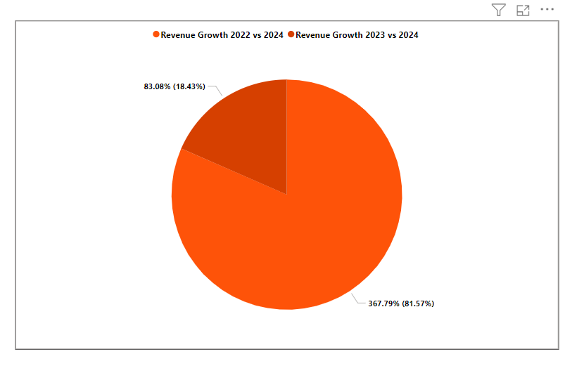
Revenue growth rate of 4-wheeler and 2-wheelers EVs in India for 2022 vs 2024 and 2023 vs 2024, assuming an average unit price.
2-wheeler
4-wheeler

Slide 27
KEY FINDINGS-I
Goa and Kerala lead EV adoption: These states show the highest EV penetration rates in their respective vehicle categories for FY 2024.
Southern dominance: Southern states like Kerala and Karnataka are prominent in EV adoption across both 2-wheelers and 4-wheelers.
Delhi and Goa's balanced adoption: Both states demonstrate consistent EV penetration across multiple vehicle categories.
Negative EV Penetration in States: Gujarat, Haryana, and Uttarakhand are among the states experiencing a decline in EV sales between 2022 and 2024.
Quarterly Sales Growth for Top EV Makers: Tata Motors leads the 4-wheeler EV market, with consistent growth across quarters, which significantly outperforms the competitors.
Delhi vs. Karnataka in 2024: Karnataka surpasses Delhi in both total EV sales and penetration rates, showcasing stronger adoption.
Top 4-Wheeler Makers CAGR: BMW India exhibits the highest CAGR (11.41%) from 2022 to 2024 among leading 4-wheeler EV manufacturers.

Slide 28
KEY FINDINGS-II
States with Highest Total CAGR in EV Sales: Meghalaya, Goa, and Karnataka top the list of states with the highest growth rates in EV sales between 2022 and 2024.
Seasonal EV Sales Trends: March emerges as the peak sales month in 2023 and 2024, while November shows lower sales activity.
Projected EV Sales in 2030: Maharashtra is projected to have the highest EV sales by 2030, driven by strong growth and favorable market dynamics.
Revenue Growth for EVs: From 2022 to 2024, 4-wheelers experienced higher revenue growth (367.79%) compared to 2-wheelers (269.28%).
Emerging Market Potential: Untapped regions like Meghalaya and Arunachal Pradesh show promising growth,and emphasizes opportunities beyond traditional markets.
Charging Infrastructure Need: Expanding EV adoption aligns with the necessity for significant investments in charging infrastructure and localized manufacturing to sustain growth.

Slide 29
CONCLUSIONS
Regional Adoption Trends: Southern states like Kerala and Karnataka lead EV adoption, while Goa and Delhi show balanced penetration.
Underperforming States: Negative sales trends in Gujarat, Haryana, and Uttarakhand highlight the need for targeted strategies.
Key Market Players: Tata Motors and BMW India drive growth in the 4-wheeler segment, with untapped potential in regions like Meghalaya and Arunachal Pradesh.
Future Projections: Maharashtra is projected to dominate by 2030, emphasizing seasonal and regional dynamics.
Growth Strategies: Focus on infrastructure expansion, incentives for low-performing regions, and replication of successful models for equitable EV adoption.

Slide 30
RECOMMENDATIONS
Focus on low-performing regions: Target states with lower EV penetration, like Maharashtra (10.07% for 2-wheelers) and Delhi (4.29% for 4-wheelers), with better incentives and infrastructure development.
Expand EV infrastructure: Invest in charging stations and EV-friendly policies, particularly in urban centers and northern regions.
Leverage success stories: Replicate policies from Goa and Kerala in other states to boost EV adoption nationwide.
Data-Driven Approach: Regularly monitor EV adoption data to identify trends and improve decision-making for targeted interventions.

Slide 31


Thank You!
Please feel free to reach out if you have queries

